Slide 1
Steel Production
Student’s Name
Institutional Affiliation

Slide 2
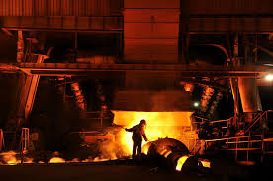
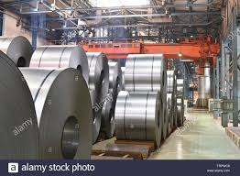
Steel Production
Steel production occurs in two main methods:
Integrated smelting in a blast furnace
And oxygen furnace and
electric arc furnace
Oxygen Furnace
This is the most production method which
involves combining iron with steel scraps and flux
After the above products are combined in a vessel, a lance is introduced and the combination blown with 99% of pure oxygen
This process increases the temperature to about 1700 degrees Celsius
The above process removes the impurities in the scrap melts through oxidation as well as reduces the carbon content by 90%
The resulting liquid is steel,
which is left to cool and cut it into various pieces
for supply as shown in this image
Notes:
Steel production involves various process. Singh (2009) explains that steel mills are used to manufacture steel from iron ore. Since the molten iron contains carbon and other impurities, passing it through oxygen chamber and heating it to about 1700 degrees Celsius ensures that these impurities are removed and the final product is clean.

Slide 3
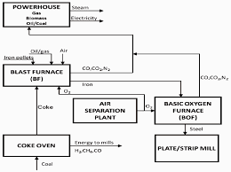
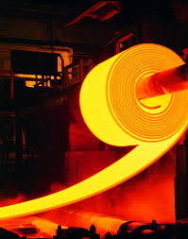
Continuation of Production Method
The above flow-chart shows a comprehensive process in steel production.
Even though the basic oxygen furnace is the main production method, steel can be manufactured through other process like electric arc furnaces
The electric arc furnace is a process that is used in the recycling of steel because it involves reuse of existing steel
This method does not use coal as a raw material like in the first method, but it relies on electricity-generated coal
Notes:
Steel production can also be produced through the recycling method, electric arc furnace which does not involve raw material, iron ore. Like the first method, discussed in the first slide, the electric arc furnace method is equally effective and efficient.

Slide 4
Reference
Singh, R. (2009). Cast Iron Metallurgy. Materials performance, 48(9), 58-61.

